Slide 1
Lending Club Case Study SUBMISSION
Group members:
Siddakka Saptasagare
Kumaraguru Muthuraj

Slide 2
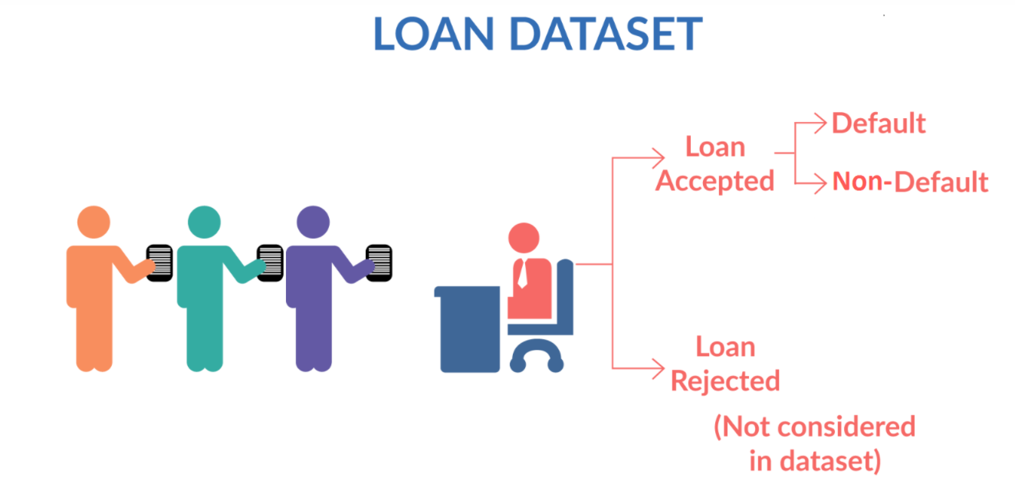
Objective of the case Study
When applicants apply for the loan there will be 2 possible cases:
Loan Accepted
Loan Rejected
When Loan is accepted it has 3 possible results as below:
Fully Paid: applicant pays the full loan amount
Current: applicant is still paying the EMI
Charged off : applicant has not paid the loan for some period of time. He/She may become defaulter
When the loan defaults, it will cause great loss to the lending company.
Identifying the risky loan applicants and the driving factors for the loan default will benefit the company.

Slide 3
Analysis and Problem Solving process
Understanding the Business Objective
Loading the input data set
Cleaning and standardizing the data
Exploratory data analysis
- Load the data file
- Extract and read the csv
- Drop unused columns
- Convert data type to correct format
- Perform univariate analysis
- Check the distribution and frequency of data
- Create derived columns to ease the analysis process
- Perform bivariate analysis
- Check the impact of variable on loan status
- Check the correlation b/w numeric variables
- Filter the data as per highest significant factor
- Perform multi-variate analysis
- Plot different graphs to visualize the results
- Summarize the result
- Conclusion about the loan risk factor

Slide 4
Executive Summary
Risk factors identified by analyzing paid-off and charged-off loans
Risk 1 - Loan grades E, F and G are higher risk loans. Looks like LC is already charging higher interest rate to recover faster. When LC issues a high loan amount they have to look at other risk factors listed further. A, B, C and D have high risk of defaulting.
Risk 2 - Most of the loans above interest rate 15% are at the risk of being charged-off. If interest rate is kept lower in the range of 8 - 11%, the risk of charging-off reduces.
Risk 3 - Debt consolidation, credit card, small business, other and home improvement reasons have highest charged off debts.
Risk 4 - Rental and Mortage home dwellers have higher charged-off status than owners. A customer from rental home is risky, followed by mortgagers.
Risk 5 - The ratio of bankruptcy counts to none is higher for charged-off customers. If a customer declared bankruptcy before, he is more likely to default.
Risk 6 - States grouped based on geography, indicate West region has taken more loans. A loan request from western states is risky, especially California.

Slide 5
Executive Summary
Risk factors identified by analyzing charged-off
loans in top 4 – states, issued months and purposes
Risk 7 - For either terms, if the interest rate is reduced, defaulting behavior can be reduced.
Risk 8 - Giving loan to a customer under the Top 4 criteria with income less than 40K and grade A, B and C is risky.
Risk 9 - Issuing loans in Sep-Dec (specifically Nov and Dec), for the 4 states with debt consolidation as purpose is risky. Customers ask for loan with debt consolidation as a reason in the 4 (especially California) states and default maximum. Towards the end of the year, as celebration begins, customers prepare to take the loan and default.
Risk 10 - Lending money to customers fitting top 4 criteria with employment length less than 2 years is risky.
Risk 11 - If a customer fitting top 4 criteria in rental home, applies for loan with purpose debt consolidation in the last 4 months, its risky.
Risk 12 - When loans are issued without source verification, they are very risky.
Risk 13 - Risky to give loans to rental customers with higher DTI.

Slide 6
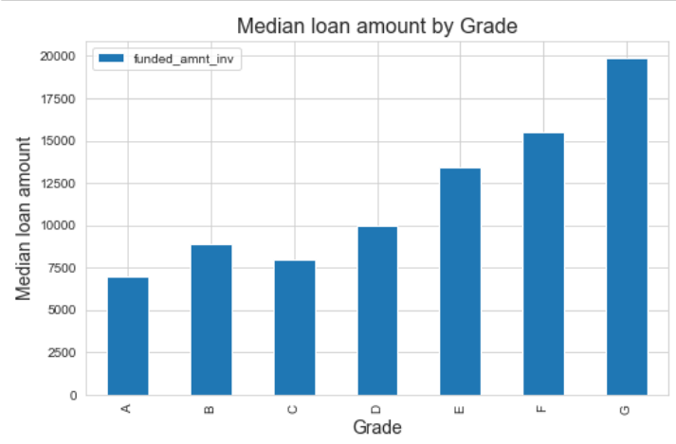
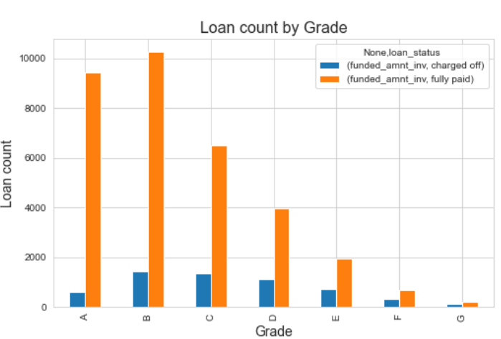
Loan grades E, F and G are higher risk loans. Looks like LC is already charging higher interest rate to recover faster. When LC issues a high loan amount they have to look at other risk factors listed further. A, B, C and D have high risk of defaulting.

Slide 7
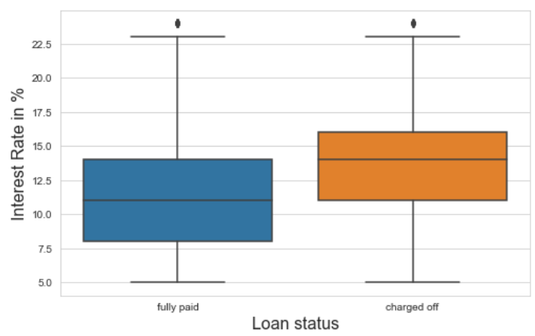
Most of the loans above interest rate 15% are at the risk of being charged-off. If interest rate is kept lower in the range of 8 - 11%, the risk of charging-off reduces.

Slide 8
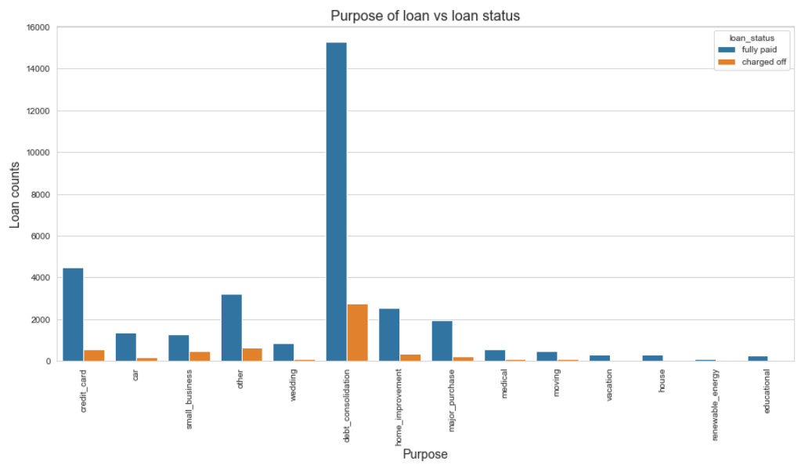
Debt consolidation, credit card, small business, other and home improvement reasons have highest charged off debts.

Slide 9
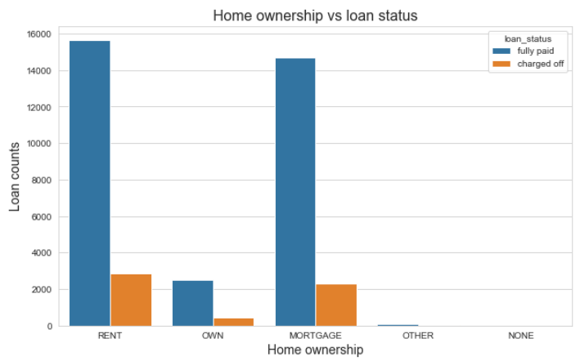
Rental and Mortage home dwellers have higher charged-off status than owners. A customer from rental home is risky, followed by mortgagers.

Slide 10
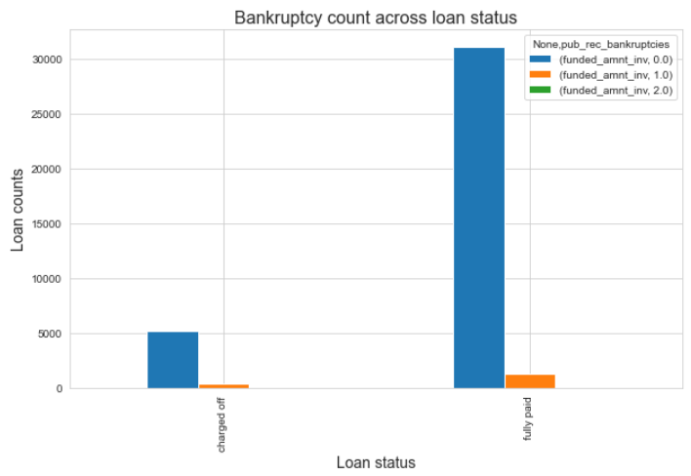
The ratio of bankruptcy counts to none is higher for charged-off customers. If a customer declared bankruptcy before, he is more likely to default.

Slide 11
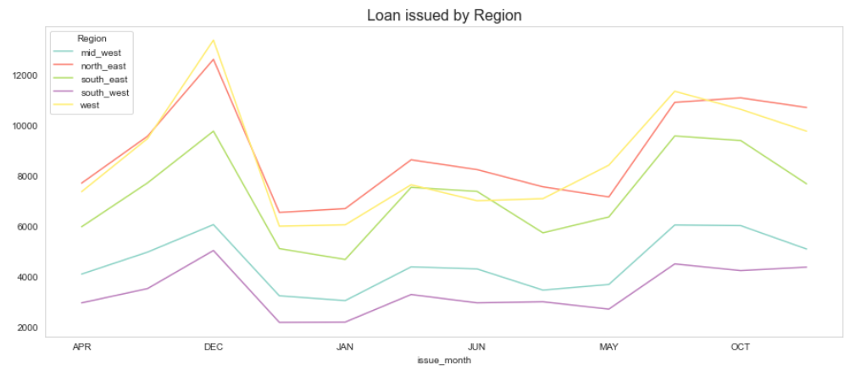
States grouped based on geography, indicate West region has taken more loans. A loan request from western states is risky, especially California.

Slide 12
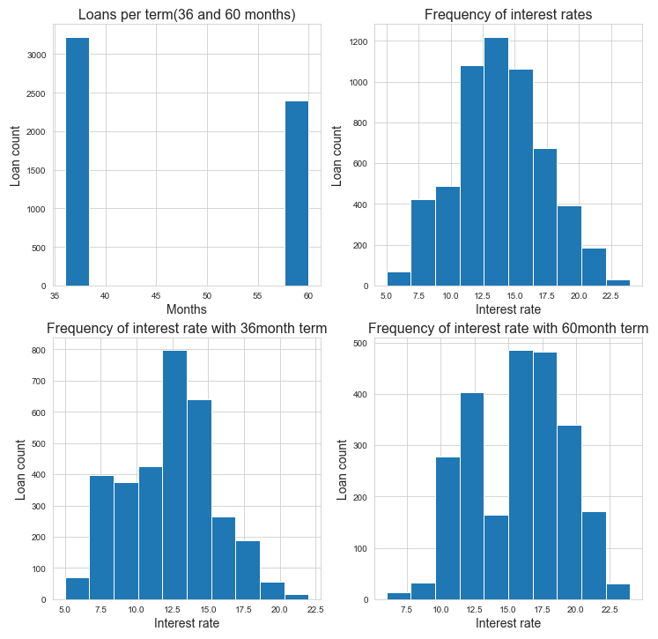
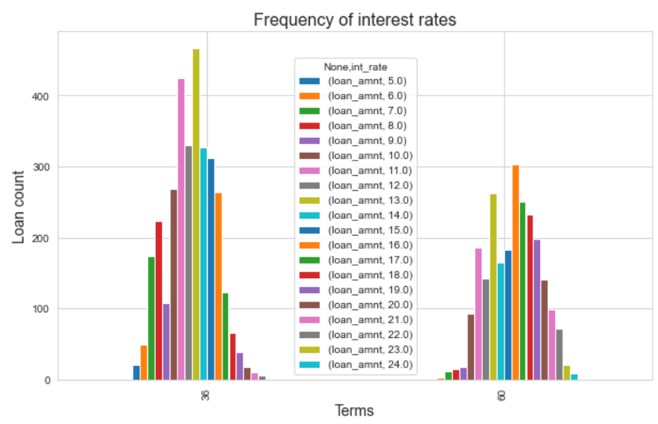
For either terms, if the interest rate is reduced, defaulting behavior can be reduced

Slide 13
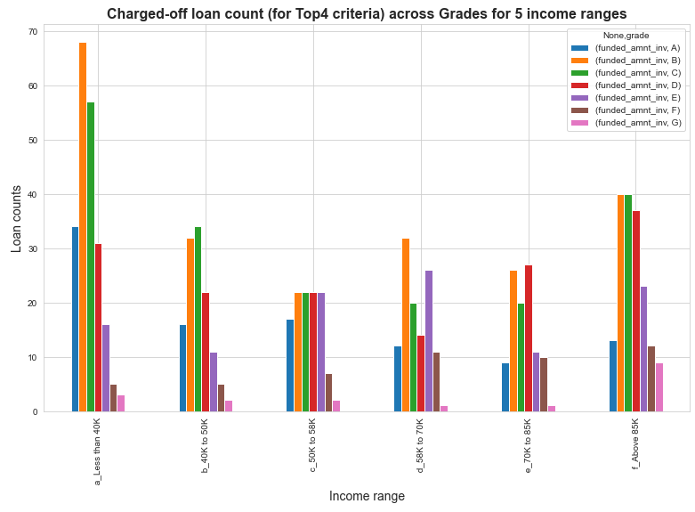
Giving loan to a customer under the Top 4 criteria with income less than 40K and grade A, B and C is risky.

Slide 14
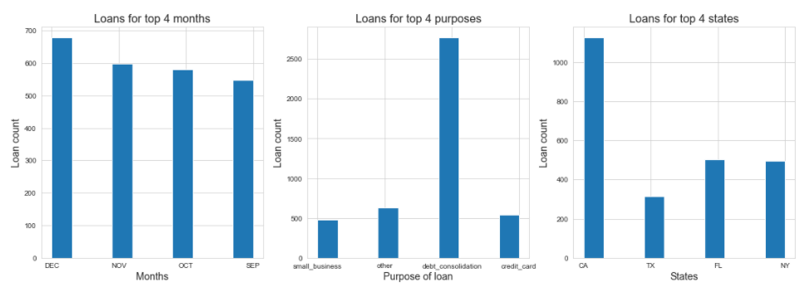
Issuing loans in Sep-Dec (specifically Nov and Dec), for the 4 states with debt consolidation as purpose is risky. Customers ask for loan with debt consolidation as a reason in the 4 (especially California) states and default maximum. Towards the end of the year, as celebration begins, customers prepare to take the loan and default.

Slide 15
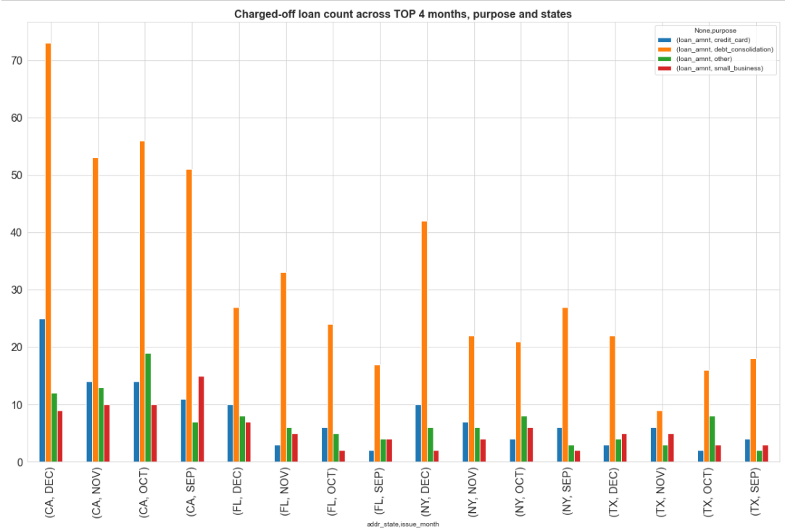
Issuing loans in Sep-Dec (specifically Nov and Dec), for the 4 states with debt consolidation as purpose is risky. Customers ask for loan with debt consolidation as a reason in the 4 (especially California) states and default maximum. Towards the end of the year, as celebration begins, customers prepare to take the loan and default.

Slide 16
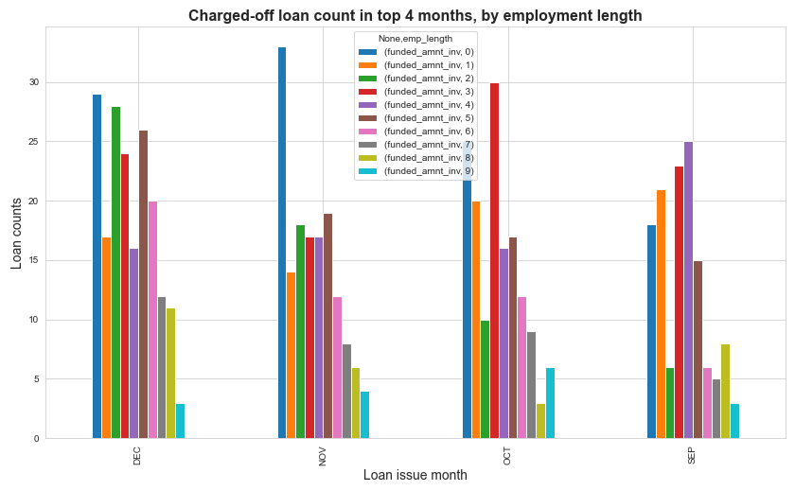
Lending money to customers fitting top 4 criteria
with employment length less than 2 years is risky

Slide 17
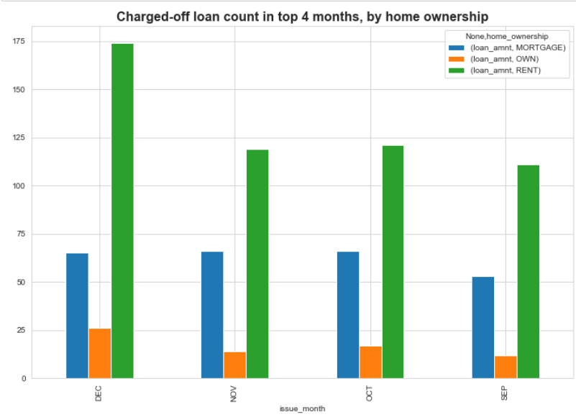
If a customer fitting top 4 criteria in rental home, applies for
loan with purpose debt consolidation in the last 4 months, its risky.

Slide 18
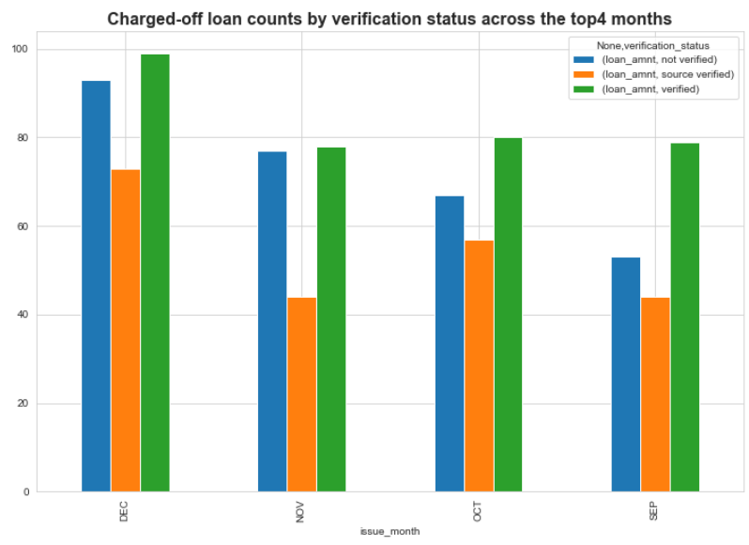
When loans are issued without source verification, they are very risky.

Slide 19
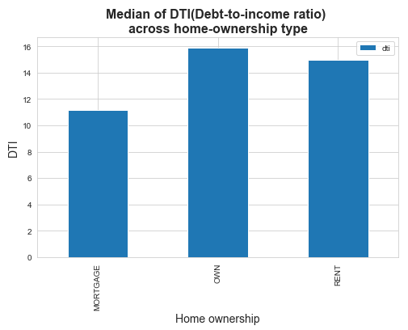
Risky to give loans to rental customers with higher DTI.

Slide 20
Conclusion
From this EDA analysis of Lending Club, we conclude that many factors, like the month of issue of loan, state where it was issued, purpose of loan are directly linked to defaulting tendency.
Many other factors like employment length, DTI, income verification, funded loan amount, interest of loan influence the loan defaulting nature.
Whenever LC receives an application they can derive a risk score as a factor of all the above parameters by assigning a weightage to them.
Consider LC tightly controls loan applications with the following overlapping conditions:
Customers with less than 2 years of experience
Loan grade is A, B or C
Purpose of loan is debt consolidation, other, credit card, small business
Rental customers
Income is less than 58K.
LC could have converted 2916 charged-off loans worth USD20,038,752 to good loans (of the total 5627 charged-off loans worth USD61,131,728) which is 32%

